Slide 1

The material in this presentation belongs to St. Francis Institute of Technology and is solely for educational purposes. Distribution and modifications of the content is prohibited.
St. Francis Institute of Technology
R&D Committee of Department of Information Technology
Innovation and Invention
An Obstacle Avoiding Voice Control Robot using IEEE 802.15.1
Presented by –
Alsten Vaz
Vedant Zalke
David Rodrigues
Devesh sharma
Under the mentorship of -
Mrinmoyee Mukherjee
St. Francis Institute of Technology
Department of Information Technology
Innovation & Invention Scheme - Round 2
An Obstacle Avoiding Voice Controlled Robot using IEEE 802.15.1
1

Slide 2
Outline of the Presentation
The material in this presentation belongs to St. Francis Institute of Technology and is solely for educational purposes. Distribution and modifications of the content is prohibited.
Introduction
Problem Statement and Objectives
Novelty of the Project
System Design
Circuit Diagram
Pin Configuration
System Requirements and Estimated Cost
Conclusion
References
St. Francis Institute of Technology
Department of Information Technology
Innovation & Invention Scheme - Round 2
An Obstacle Avoiding Voice Controlled Robot using IEEE 802.15.1
2

Slide 3
Introduction
The material in this presentation belongs to St. Francis Institute of Technology and is solely for educational purposes. Distribution and modifications of the content is prohibited.
Sensor networks are large scale networks consisting of several nodes and some base stations, here nodes are often battery powered and communicate between each other, while the base stations provide secure and reliable operations.
International Federation of Robotics (IFR) defines a service robot as a robot which operates semi- or fully autonomously to perform services useful to the well-being of humans and equipment, excluding manufacturing operations and these mobile robots are currently used in many fields of applications.
Robots are immersing as an expensive yet efficient alternative to human labour however there are many complications to such systems.
The robotic car developed will be efficient and can be remotely operated from ones phone via bluetooth.
St. Francis Institute of Technology
Department of Information Technology
Innovation & Invention Scheme - Round 2
An Obstacle Avoiding Voice Controlled Robot using IEEE 802.15.1
3

Slide 4
Problem Statement and Objectives
The material in this presentation belongs to St. Francis Institute of Technology and is solely for educational purposes. Distribution and modifications of the content is prohibited.
Problem Statement:
The project aims to develop an obstacle avoiding voice control robot using IEEE 802.15.1 via bluetooth which detects an obstacle before moving in any direction.
Objective:
The above system is developed using IEEE 802.15.1, ultrasonic sensor, IR sensor, two 3.7V batteries power supply and motors embedded on the system. This system will be controlled by a mobile app via bluetooth.
St. Francis Institute of Technology
Department of Information Technology
Innovation & Invention Scheme - Round 2
An Obstacle Avoiding Voice Controlled Robot using IEEE 802.15.1
4

Slide 5
Novelty of the Project
The material in this presentation belongs to St. Francis Institute of Technology and is solely for educational purposes. Distribution and modifications of the content is prohibited.
The developed project is a lifelong, one-time investment. The robot does not only perform for industrial purposes but the robot can be modified later on also.
The voice and the movability are likely to be the same as many other projects, but we have given more space on the bot and well a properly managed design.
A rotating ultrasonic sensor that has a particular degree angle, and a buzzer on the back of the bot, enhance the project for not only one purpose but also many more.
St. Francis Institute of Technology
Department of Information Technology
Innovation & Invention Scheme - Round 2
An Obstacle Avoiding Voice Controlled Robot using IEEE 802.15.1
5

Slide 6
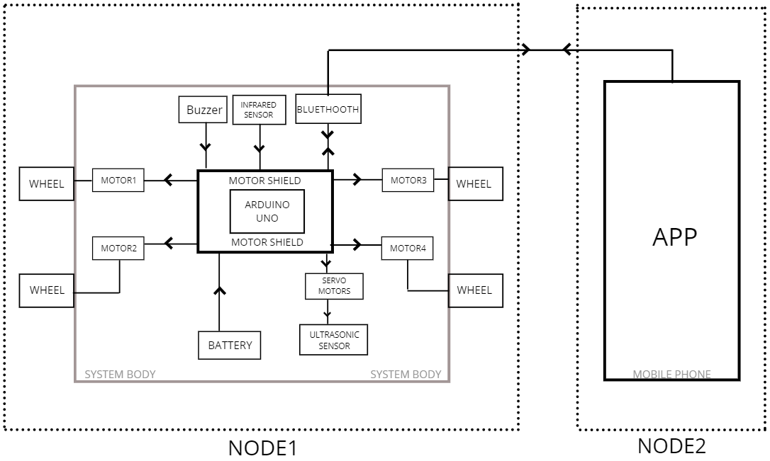
System Design
The material in this presentation belongs to St. Francis Institute of Technology and is solely for educational purposes. Distribution and modifications of the content is prohibited.
FIg 1. System diagram
St. Francis Institute of Technology
Department of Information Technology
Innovation & Invention Scheme - Round 2
An Obstacle Avoiding Voice Controlled Robot using IEEE 802.15.1
6

Slide 7
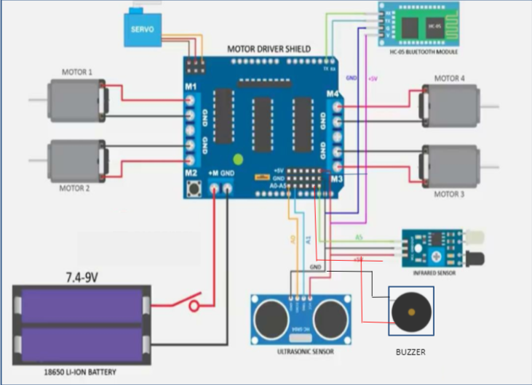
Circuit Diagram
The material in this presentation belongs to St. Francis Institute of Technology and is solely for educational purposes. Distribution and modifications of the content is prohibited.
Fig 2. Circuit diagram
St. Francis Institute of Technology
Department of Information Technology
Innovation & Invention Scheme - Round 2
An Obstacle Avoiding Voice Controlled Robot using IEEE 802.15.1
7

Slide 8
Pin Configuration
The material in this presentation belongs to St. Francis Institute of Technology and is solely for educational purposes. Distribution and modifications of the content is prohibited.
Motor Driver Shield | HC-05 Bluetooth module
+5V | Vcc
Ground | Ground
D0 | Tx
D1 | Rx
Motor Driver Shield | Ultrasonic Sensor
A0 | Echo
A1 | Trigger
+5V | Vcc
Ground | Ground
St. Francis Institute of Technology
Department of Information Technology
Innovation & Invention Scheme - Round 2
An Obstacle Avoiding Voice Controlled Robot using IEEE 802.15.1
8

Slide 9
Pin Configuration
The material in this presentation belongs to St. Francis Institute of Technology and is solely for educational purposes. Distribution and modifications of the content is prohibited.
Motor Driver Shield | IR Sensor
+5V | Vcc
Ground | Ground
A5 | Output
St. Francis Institute of Technology
Department of Information Technology
Innovation & Invention Scheme - Round 2
An Obstacle Avoiding Voice Controlled Robot using IEEE 802.15.1
9

Slide 10
System Requirements and Estimated Cost
The material in this presentation belongs to St. Francis Institute of Technology and is solely for educational purposes. Distribution and modifications of the content is prohibited.
Hardware Requirements
Sr. No. | Name of the Component | Price per unit | No.of units | Total price ₹
1 | Arduino uno | 150 | 1 | ₹250
2 | HC-05 Bluetooth module | 200 | 1 | ₹200
3 | Motors driver shield | 300 | 1 | ₹300
4 | Jumper wires | 5 | 20 | ₹100
5 | Battery | 450 | 2 | ₹900
6 | IR sensor | 200 | 1 | ₹200
7 | Body Motors | 250 | 4 | ₹1000
St. Francis Institute of Technology
Department of Information Technology
Innovation & Invention Scheme - Round 2
An Obstacle Avoiding Voice Controlled Robot using IEEE 802.15.1
10

Slide 11
System Requirements and Estimated Cost
The material in this presentation belongs to St. Francis Institute of Technology and is solely for educational purposes. Distribution and modifications of the content is prohibited.
8 | Ultrasonic | 170 | 1 | ₹170
9 | Body | 1350 | 1 | ₹1350
10 | Servo motor | 250 | 1 | ₹250
11 | Buzzer | 35 | 1 | ₹35
 |  |  | TOTAL | ₹4755
Software Requirements
Sr. No. | Software name | Software price | Total cost
1 | Arduino IDE | Open source | ---
St. Francis Institute of Technology
Department of Information Technology
Innovation & Invention Scheme - Round 2
An Obstacle Avoiding Voice Controlled Robot using IEEE 802.15.1
11

Slide 12
Conclusion
The material in this presentation belongs to St. Francis Institute of Technology and is solely for educational purposes. Distribution and modifications of the content is prohibited.
The objective of this task is to make an independent robot that wisely distinguishes the objects in its way.
The robot is voice controlled and its controlled by an app.
To assist the physically disabled and can be used in complex robots in future,the total cost of this project is ₹4,755.
St. Francis Institute of Technology
Department of Information Technology
Innovation & Invention Scheme - Round 2
An Obstacle Avoiding Voice Controlled Robot using IEEE 802.15.1
12

Slide 13
References
The material in this presentation belongs to St. Francis Institute of Technology and is solely for educational purposes. Distribution and modifications of the content is prohibited.
[1]Bhuvan MS, Manjunath K, ”Obstacle Avoiding Vehicle”,INTERNATIONAL RESEARCH JOURNAL OF ENGINEERING AND TECHNOLOGY (IRJET)” Volume: 07, SPECIAL ISSUE | JUNE 2020
[2]Kolapo Sulaimon Alli, Moses Oluwafemi Onibonoje, Akinola S. Oluwole, Michael Adegoke Ogunlade, Anthony C. Mmonyi, Oladimeji Ayamolowo and Samuel Olushola Dada, “Development of an arduino based obstacle avoidance robotic system for an unmanned vehicle“, ARPN Journal of Engineering and Applied Sciences VOL. 13, NO. 3, FEBRUARY 2018
[3] Pavithra A C, Subramanya Goutham V,“Obstacle Avoidance Robot Using Arduino”, International Journal of Engineering Research & Technology (IJERT),Special Issue - 2018
[4]Md. Amirul Islam , Nishat Halim Sharif , Md. Shahriar Parvez Tameem , S. M. Mazharul Hoque Chowdhury , Moriom Chowdhury Kumu , Md. Fokhray Hossain, “IoT Based Robot with Wireless and Voice Recognition Mode”,Department of Computer Science and Engineering, Daffodil International University, Dhaka, Bangladesh 2018.
[5] Faiza Tabassum, Susmita Lopa, Muhammad Masud Tarek & Dr. Bilkis Jamal Ferdosi.”Obstacle Avoiding Robot ”.Global Journal of Researches in Engineering: H Robotics & Nano-Tech Volume 17 Issue 1 Version 1.0 Year 2017
[6] Khan, Abdul & Priya, Kanu & Kumar, Siddhartha, “Implementation of Voice-Controlled Robotic Vehicle with Automatic Braking and Obstacle Avoidance”, An International Journal of Jaipur National University,2018.
St. Francis Institute of Technology
Department of Information Technology
Innovation & Invention Scheme - Round 2
An Obstacle Avoiding Voice Controlled Robot using IEEE 802.15.1
13

Slide 14
The material in this presentation belongs to St. Francis Institute of Technology and is solely for educational purposes. Distribution and modifications of the content is prohibited.
Thank you …
St. Francis Institute of Technology
Department of Information Technology
Innovation & Invention Scheme - Round 2
An Obstacle Avoiding Voice Controlled Robot using IEEE 802.15.1
14

